Slide 1
Millennials and Me
TU Delft
Smart Public Transport Lab
24 September 2018
Alexa Delbosc
@AlexaDelbosc

Slide 2
About me
My research areas
All about millennials
Personal reflections

Slide 3
Melbourne

Slide 4
City of 4.8 million

Slide 5
A city of sprawl and of cars
740 cars / 1,000 people
480 cars / 1,000 people
Monash
Source: Chris Loader, ChartingTransport

Slide 6
Monash is Victoria’s largest university with campuses in 5 countries

Slide 7
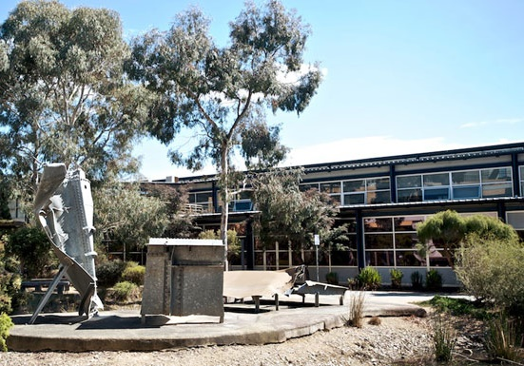
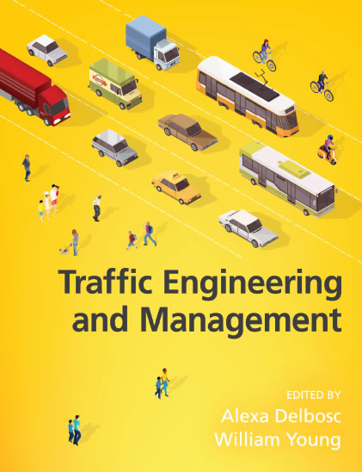
About me
Senior Lecturer at Monash Institute of Transport Studies
In the Department of Civil Engineering
Teach Traffic Engineering and Management subjects

Slide 8
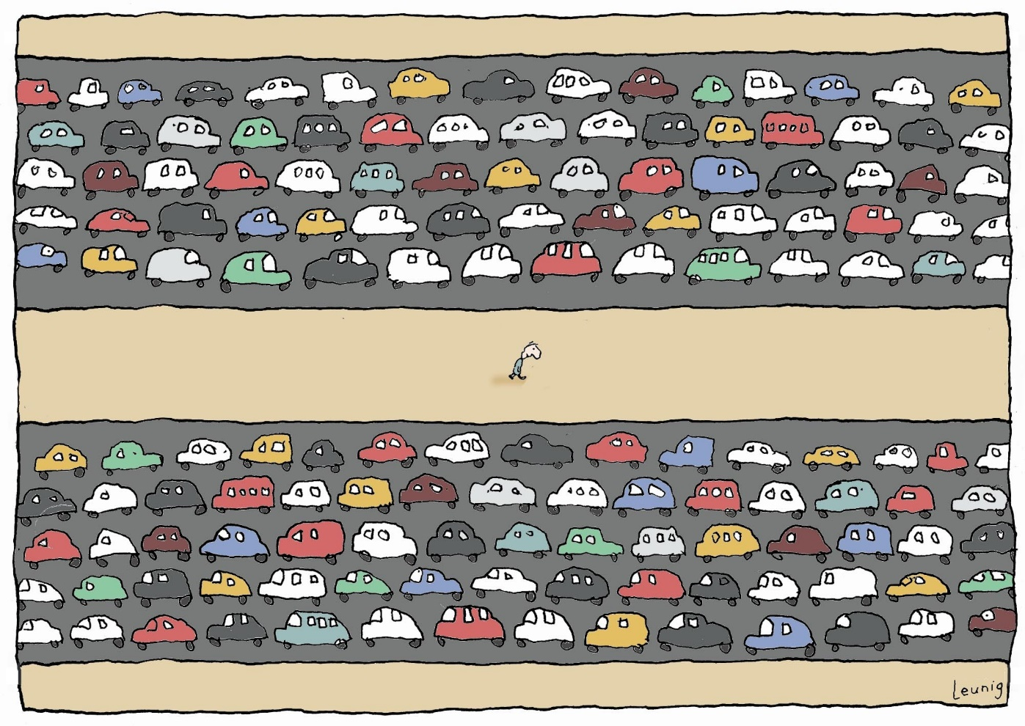
About me
Master of Social Psychology from Harvard
PhD in Transport from Monash University

Slide 9
My Research Areas

Slide 10
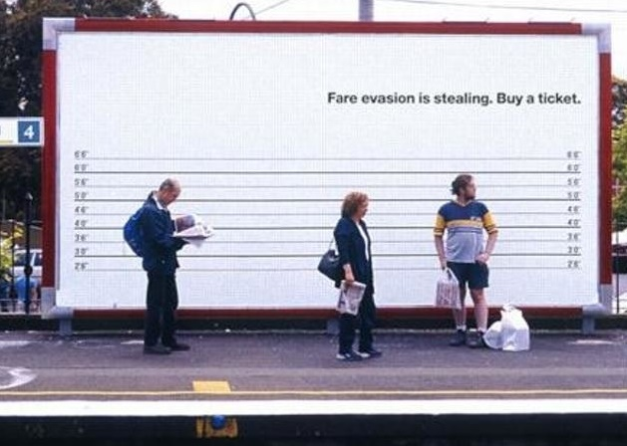
Researcher in travel behaviour and psychology
Why do people fare evade?
Is all fare evasion ‘stealing?’
How do the reasons for fare evasion differ in the population?

Slide 11
Researcher in travel behaviour and psychology
How much mobility is ‘enough’ to make you happy?
Which is more important to well-being, mobility or accessibility?

Slide 12
Researcher in travel behaviour and psychology
Why are millennials driving less than previous generations?
How is it related to their life stage?
Are they using public transport more?
How will their travel behaviour change as they age?

Slide 13
All About Millennials

Slide 14
What is in store for the future of millennials?
Huffingtonpost.com
Hometrustmortgageloansatlantageorgia.com

Slide 15
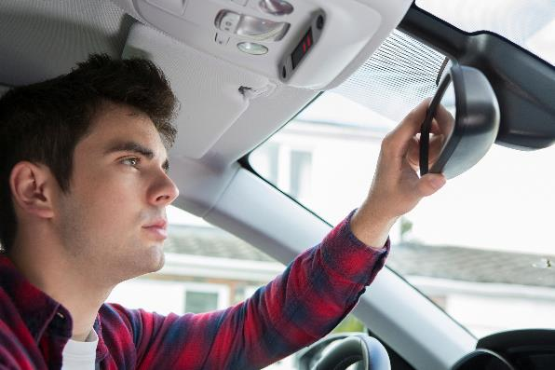
How does that relationship differ within the millennial generation?

Slide 16
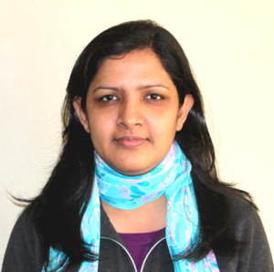
Millennial Mobility Panel Study (MMPS)
What is the relationship between future life course and travel behaviour?
How does that vary within the millennial generation?
Supported by Research Assistant
Dr Farhana Naznin

Slide 17
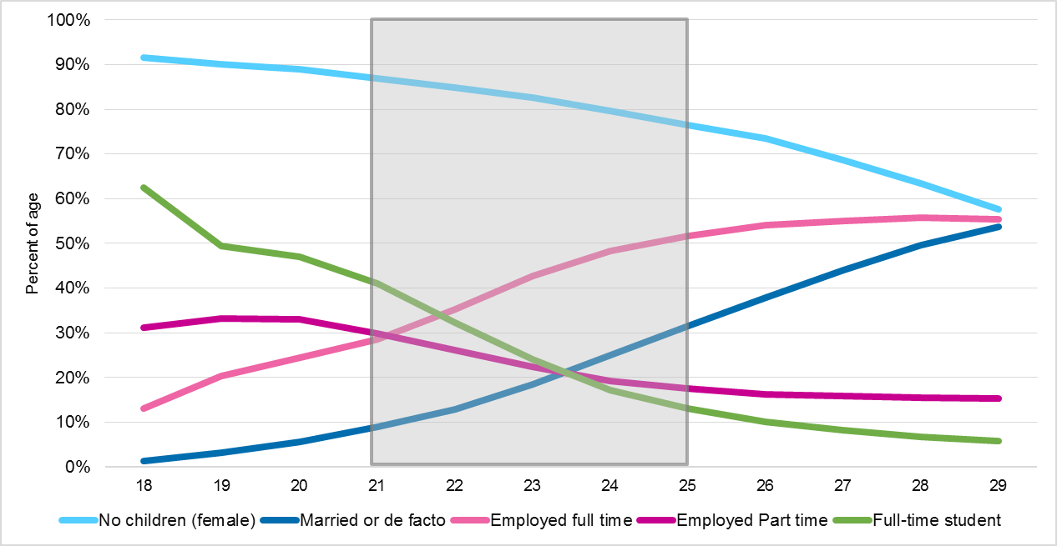
Millennial Mobility Panel Study (MMPS)
Through a survey of 21-25 year olds in Melbourne and regional Victoria

Slide 18
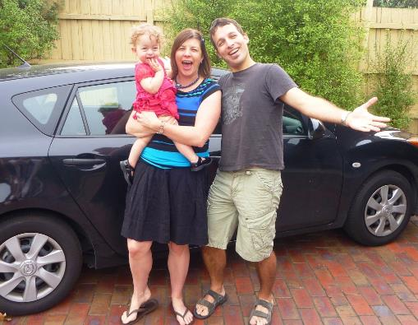
Asked how respondents saw their future unfolding
How likely is it that you will …. In the next 12 months, 3 years or by age 30?
Get a driving license (“P’s”)
Have your own car
Get a part-time job
Get a full-time job
Move out of your parent’s home
Move in with a partner
Buy a home
Get married
Have children
No chance (0)
Below-even chance (1 to 5)
Above-even chance (6 to 9)
Certainty (10)
Already done (11)

Slide 19
Latent Class Analysis identifies groupings based on responses
Traditional
In 12 months?
Launching Traditional
Get a license? Buy a car? Move out? Get a job? Marry? Have Kids? Buy a home?
Independent
Delayed with Cars
In 3 years?
By age 30?
Delayed without Cars
From 27
To five

Slide 20
Log-likelihood minimised at 5-clusters

Slide 21
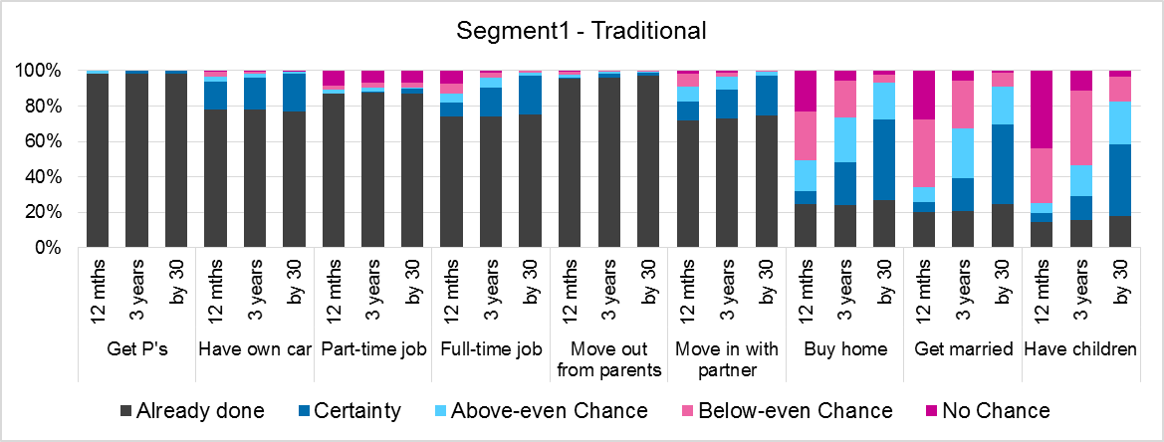
Traditional segment (24% of sample)
Working, living with a partner
Some already bought home, married, had children
More likely to live in regional Victoria (42% vs. survey average 23%)

Slide 22
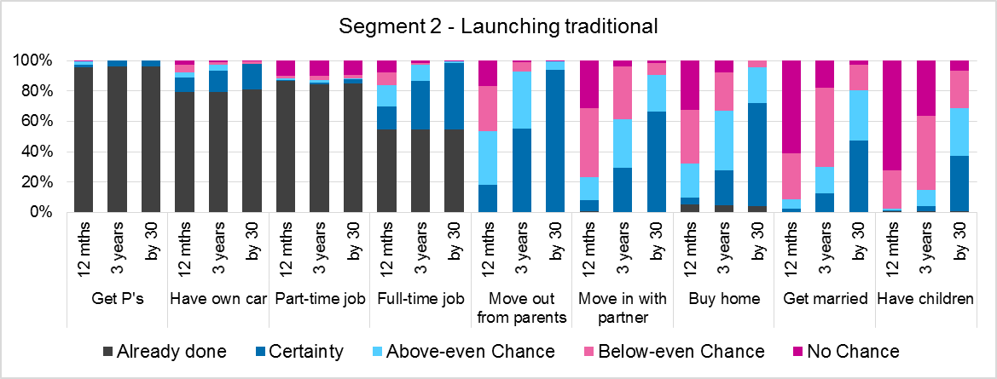
Launching Traditional segment (20% of sample)
Living at home with parents, but long-term view toward a traditional future
60% were certain or above-even to buy a home within 3 years

Slide 23
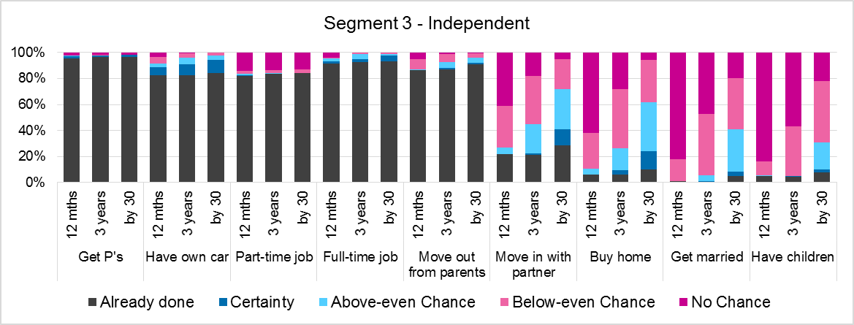
Independent segment (19% of sample)
Working full-time, living away from parents
Buying home, marriage, children not on the near horizon

Slide 24
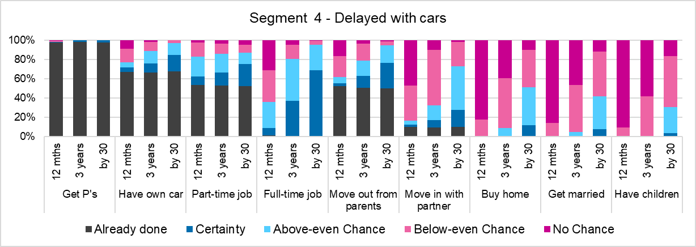
Delayed with Cars segment (21% of sample)
More likely to be studying, lower-income
Low chance of marriage, home, children
Most already have a car

Slide 25
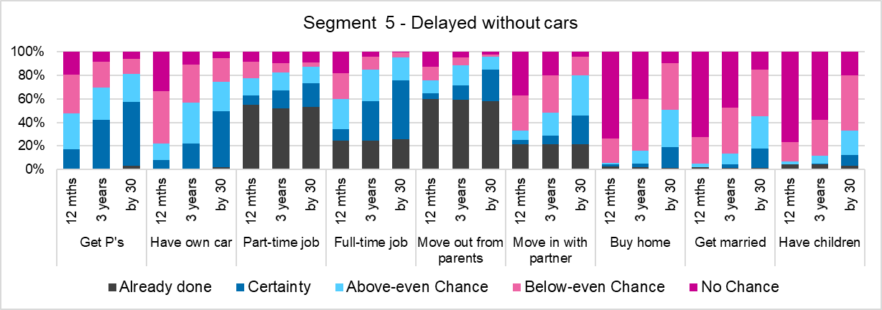
Delayed without Cars segment (16% of sample)
More likely to be studying, lower-income
Low chance of marriage, home, children
Cars are a medium-term issue
Most likely to be from overseas (29% vs. 14% of survey respondents)

Slide 26
Life stage strongly associated with transport use…

Slide 27
…attitudes to transport modes…

Slide 28
…and with where they see themselves ‘settling down’

Slide 29
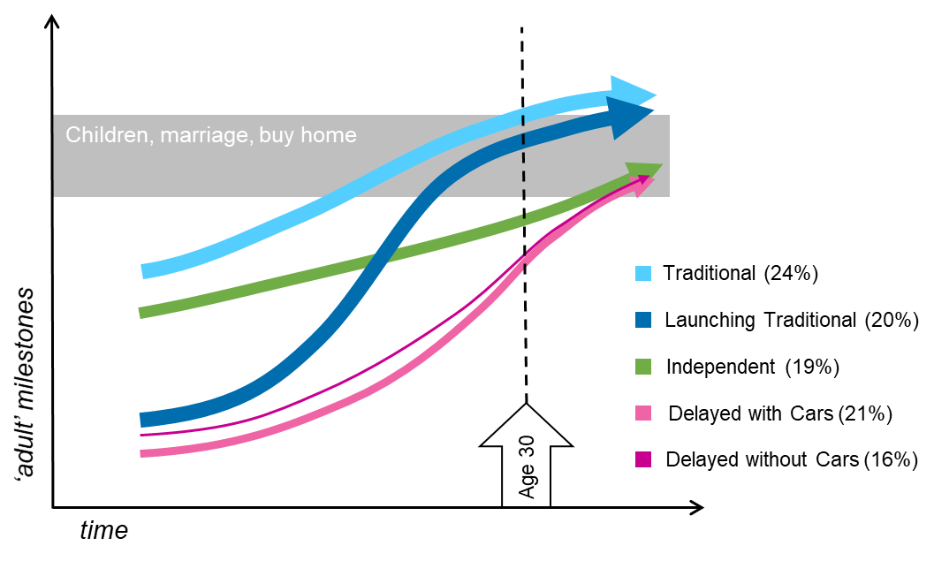
A summary of life course timelines

Slide 30
Different groups have different policy implications
 | Drivers to using alternate modes | Short-term constraints to using alternate modes | Policy options | Long-term car use
Traditional (24%) | None | Family duties, suburban/rural location, strong car use and attitudes | Few | Very high
Launching Traditional (20%) | None | Suburban location, strong car use and attitudes | Few | Very high
Independent (19%) | Prefer transit-rich and inner-city areas, somewhat multi-modal | Fairly strong car use | Support multi-modal travel, provide family housing in accessible areas | High
Delayed with Cars (22%) | Prefer transit-rich and inner-city areas, somewhat multi-modal, university students | Fairly strong car use | Support multi-modal travel, provide alternative options around universities, provide family housing in accessible areas | High
Delayed without Cars (16%) | Live in accessible areas, strongest preference for transit-rich and inner-city areas, heavy transit use, strong transit attitudes, low intent to get a car | None | Reinforce alternative modes in accessible areas, provide family housing in accessible areas | Moderate

Slide 31
A few personal reflections

Slide 32
Transport is a ‘broad church’
Geography
Economics
Public policy
Transport
Psychology
Electrical engineering

Slide 33
Cross-disciplinary research is the future
Biochemists
Social scientists
Civil engineering
Psychologist

Slide 34
Discovery Early Career Research Award
What does it take?
What do you get?
Within 5 years of your PhD
3 years of salary + project cost
Based at an Australian university
Very prestigious award
Need a top record, with a top group and a top project
You get to work with Australia’s leading public transport group
10% success rate
You get to live in Australia!

Slide 35
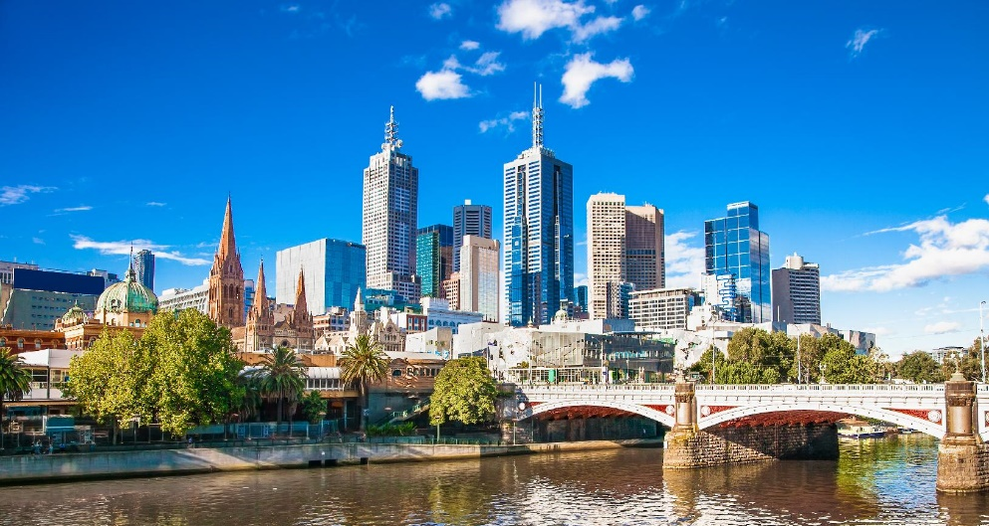
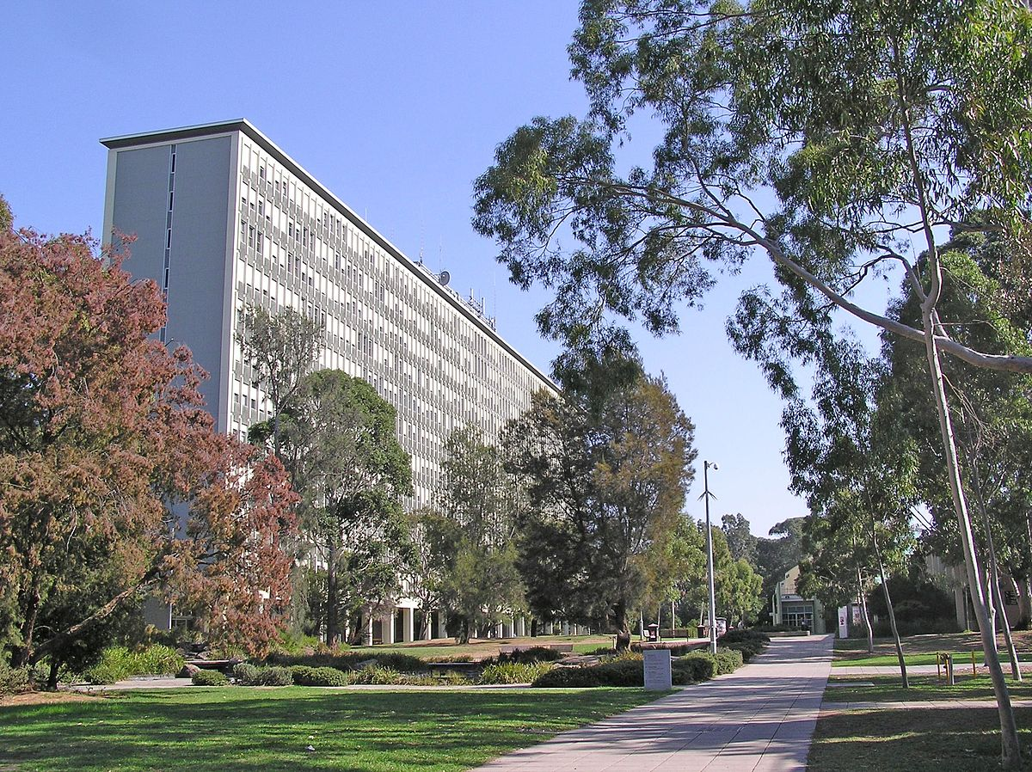
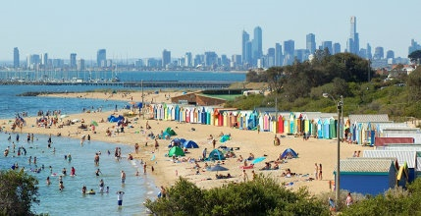
(Second) most liveable city in the world

Slide 36
Any questions?

