Slide 1
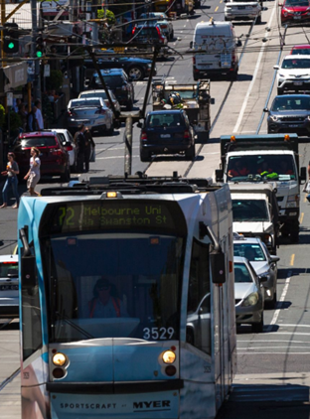
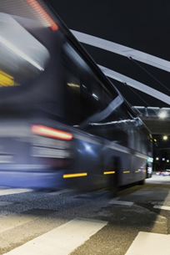
Overview – PT Research @ Monash
Hot Collaboration Topics
Prof Graham Currie FTSE, Director SEPT-GRIP
Public Transport Research Group (PTRG)
Monash University, Australia
September 2018

Slide 2
PTRG Overview
HOT COLLABORATION TOPICS
1. Optimising Revenue Protection
2. Managing Transport Disruption
3. Equity & On-Demand/Shared Mobility

Slide 3
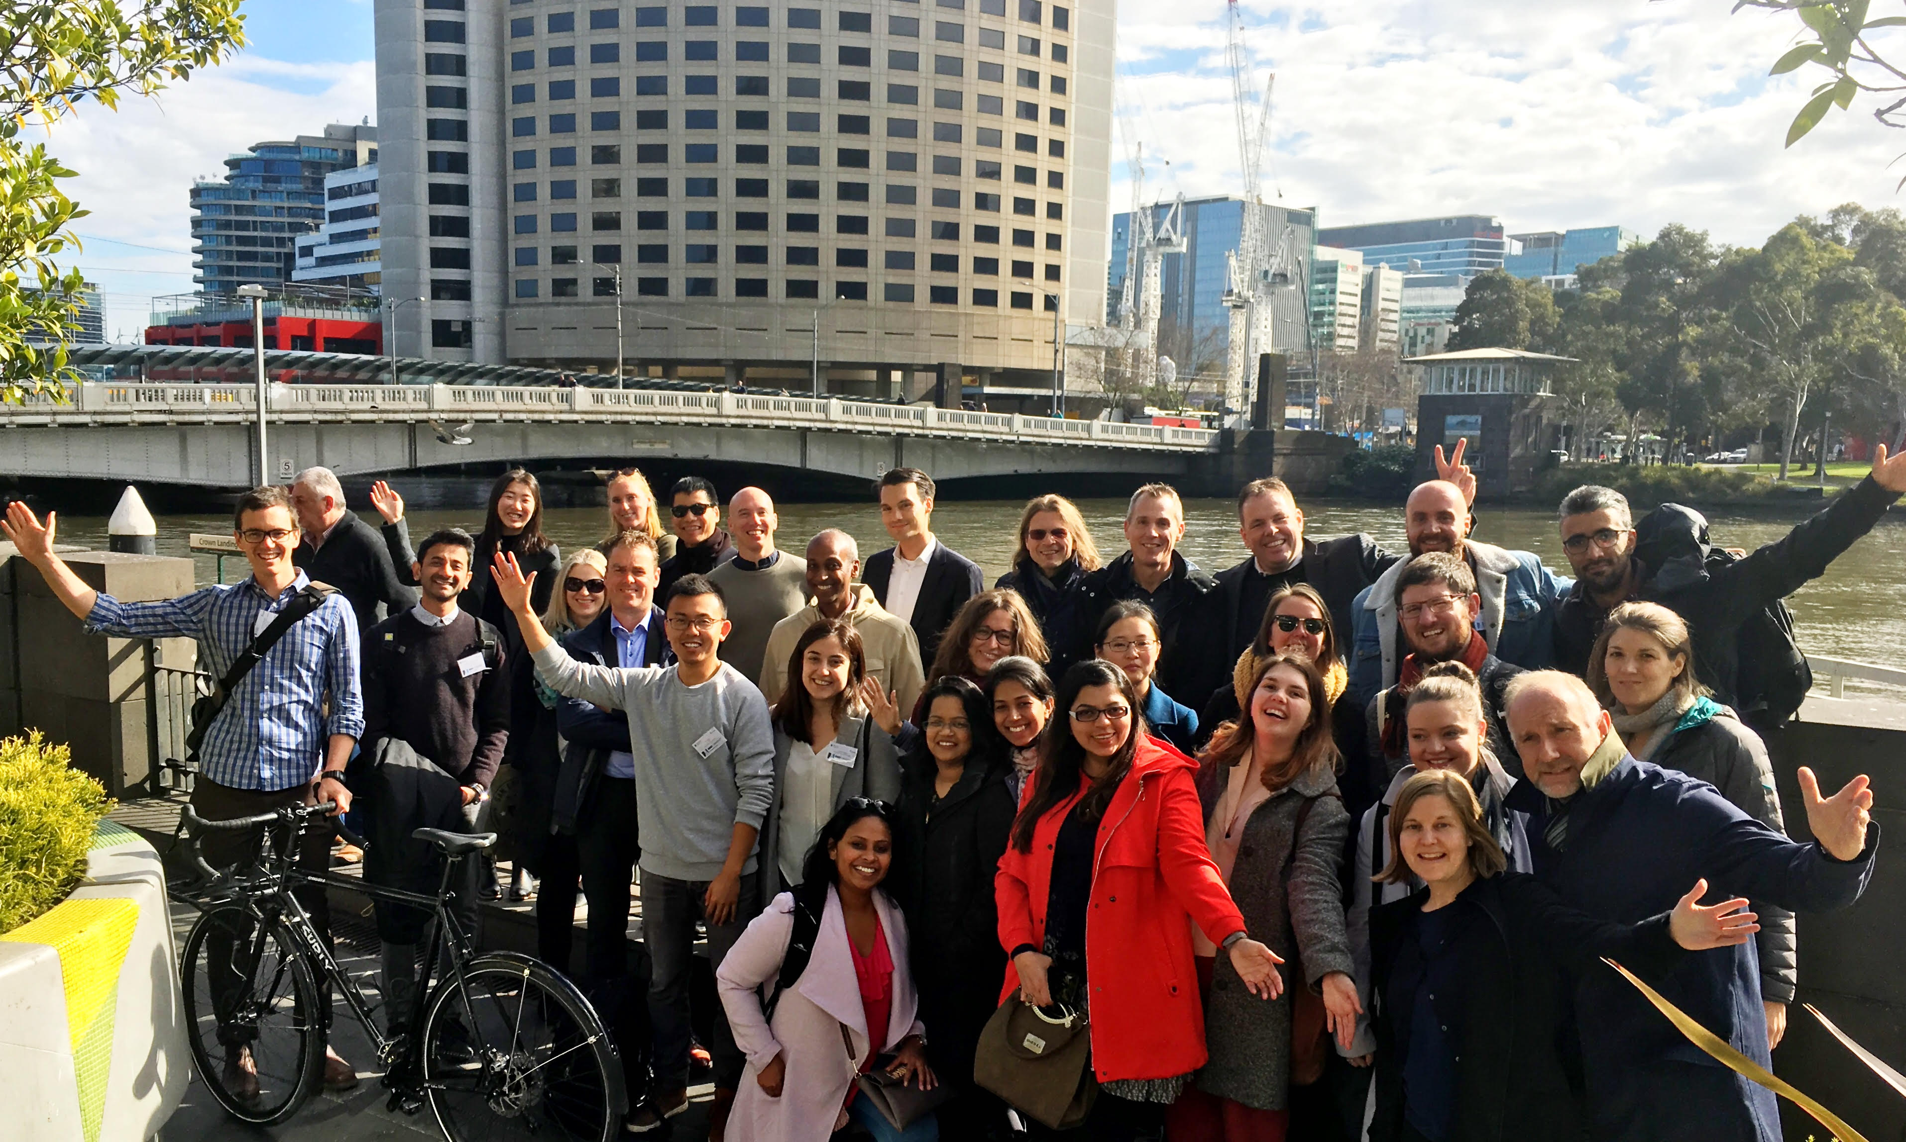

Slide 4
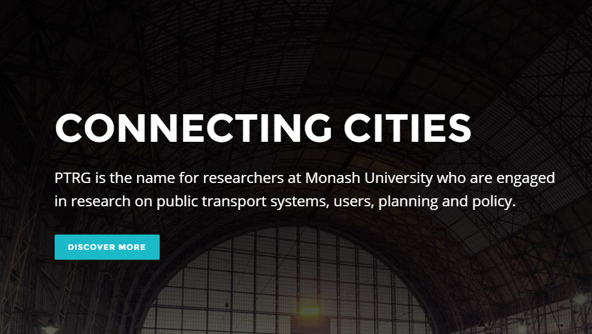



Slide 5
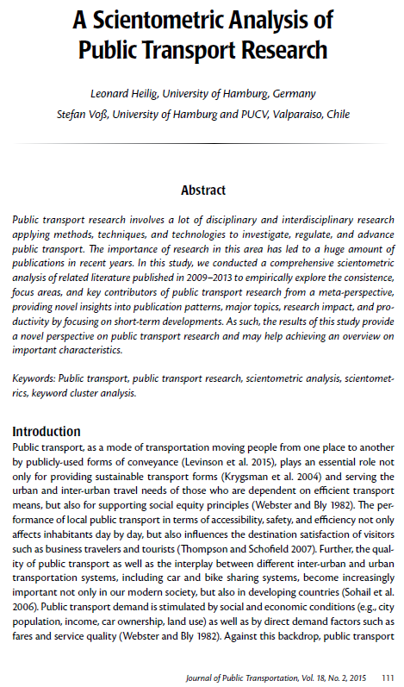
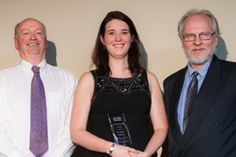
World Review of Public Transport Research (2009-2013)
Heilig L and Vos S (2015) ‘A Scientometric Analysis of Public Transport Research’ Journal of Public Transportation Vol 18 No 2
Top 3 world Universities in Public Transport Research
Uni of Toronto, UCal Berkeley, MONASH UNIVERSITY
Most Productive Authors (World Ranking)
PTRG Staff - Graham Currie 2nd, Alexa Delbosc 11th
PTRG Associates – Avi Ceder 3rd, John Nelson 10th)
Most Cited World Authors
Graham Currie 5th
International Awards
TRB Largest Transport Conference in the World (13,000 delegates)
Best Paper in Public Transport (William M Millar Award)
  2012
  2017
World Conference on Transport Research
Best research paper in Transport Policy 2016
ARRB Transport Research
  Research Impact Award 2017

Slide 6




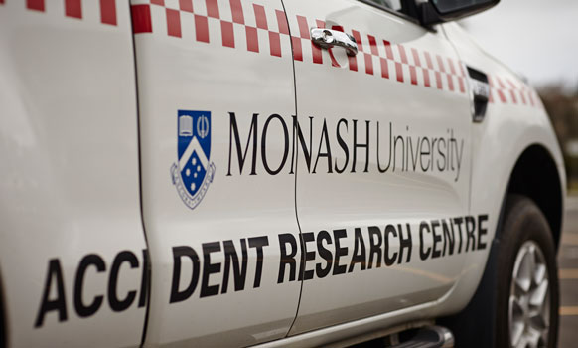
PTRG is part of a wider collaborative framework in transport research across multiple groups/ faculties
Key Research Groups
Key Research Themes
Railway Engineering & Technology
Public Transport Policy & Operations
Traffic & Transport Systems
Intelligent Transport Systems
Design in Public Transport
Model Data Fusion
Light Weight Vehicles
Aerodynamics
Transport Safety

Slide 7
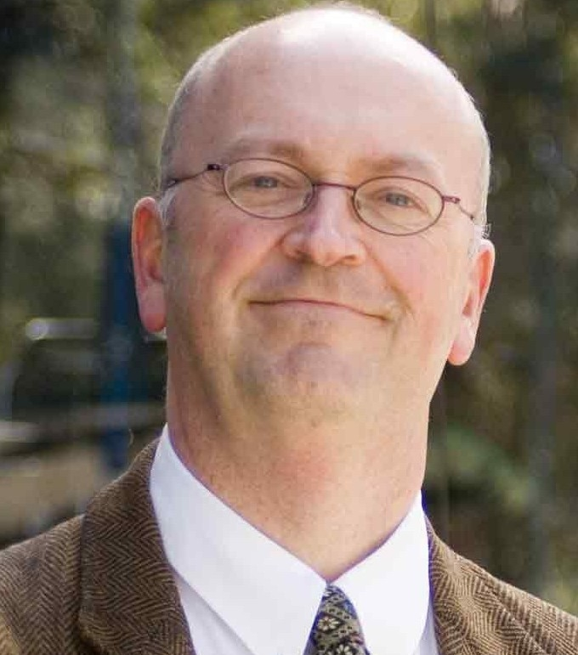
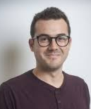
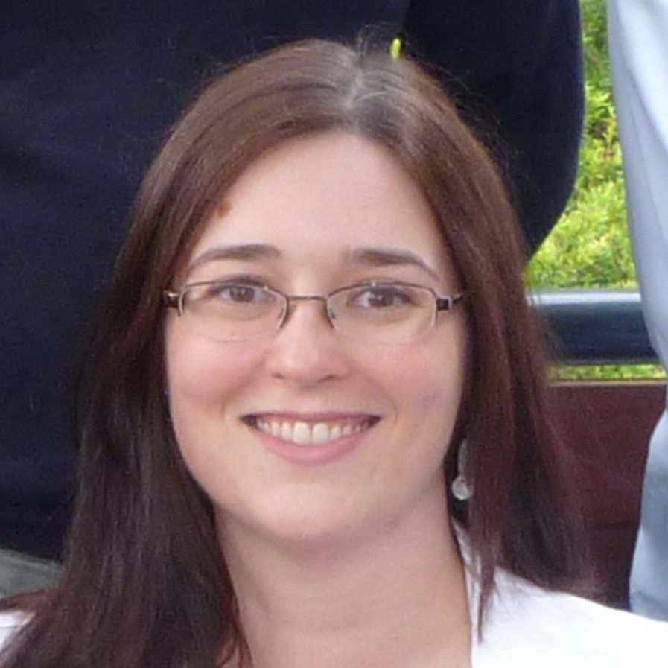




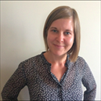

Key PTRG staff, the associate team & students
Prof Graham Currie
Chair of Public Transport
Nicholas Fournier
Research Fellow
Dr Alexa Delbosc
Senior Lecturer
DECRA Fellow
James Reynolds
Research Fellow
Katerina Pavkova
Research Fellow
Wendy Walker
Website Manager
Dr Farhana Naznin
Research Fellow
27 PhD students
52 Research associates across Monash University (e.g. ITS, MADA, MUARC), International Universities, and external experts
48 Masters Students; most in China
10+ final year civil engineering undergraduate research students per year
Laura McCarthy
Research Fellow
Dr Kun An
Lecturer

Slide 8



The Chair started in 2003; in 2015 a new PTV/TFV - Monash Public Transport Research Group (PTRG) commenced
PTRG (Industry) Reference Group
Core Research
Team
PTRG Research Associates
DCE /Monash University
International Universities
PTRG GRIP
(Graduate Research Interdisciplinary Program)
18 PhD students
Faculty of Engineering/ IT/ Arts
IRT/ MUARC/ MADA / ITS
World First joint Authority/Uni. Research and Training Initiative
Starts March 1st 2015 for 5 years; then continues subject to review
$5M total funding - $ 2.5M PTV seed funding provided, $2M Monash $0.5M Industry

Slide 9
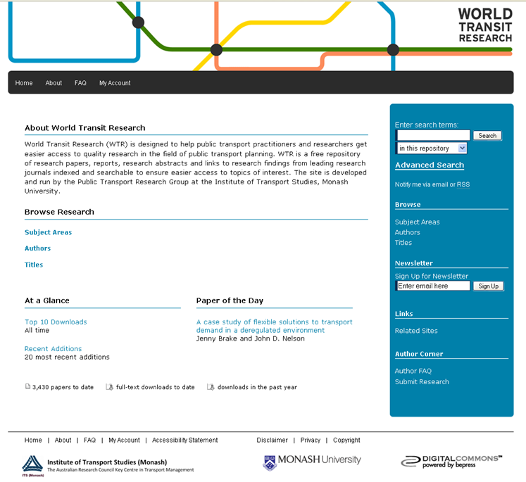
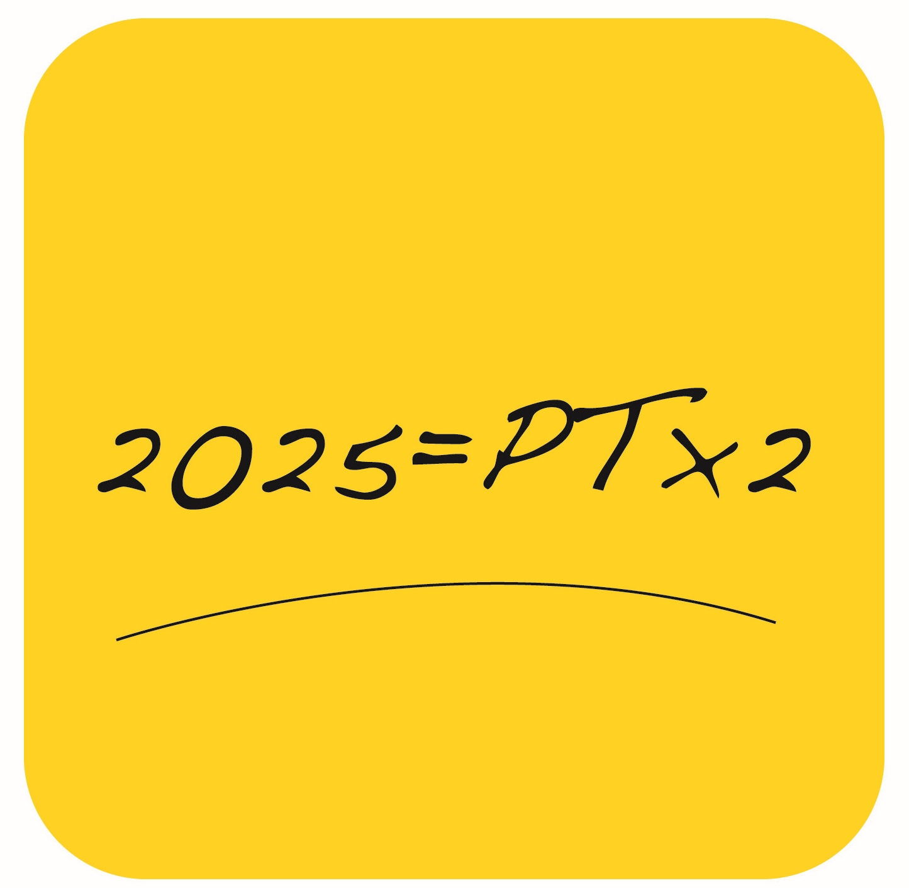
PTRG runs World Transit Research; the global research clearinghouse for public transport research
World Transit Research
Commenced 2010
256,639 site users
8,000 towns and cities from 170 countries
6,896 journal papers
World index of authors and topics
Users in the Netherlands:
  12,273 page views
www.worldtransitresearch.info
UITP Showcase Award
Winner

Slide 10


SEPT-GRIP is an initiative of the Public Transport Research Group (PTRG) at Monash…
PTRG (Industry) Reference Group
Core Research
Team
PTRG Research Associates
DCE /Monash University
International Universities
PTRG SEPT-GRIP
(Graduate Research Industry Partnership)
18 PhD students
6 Faculties plus MUARC
Sustainable and Effective Public Transport - Graduate Research Industry Partnership

Slide 11






It has 18 students, 6 faculties, 15 supervisors & 6 industry partners – the largest collation of PhD students in public transport in the world
Cohort of 18 PhD students conducting research on the theme of Sustainable and Effective Public Transport (SEPT)
Representation from 6 Faculties & MUARC from diverse disciplines
Industry support through industry scholarships: PTV (4), Metro Trains (1), Yarra Trams (1), VicRoads (1), Transdev (1), BusVic (1) and Monash (9)
Customised professional development program offered to students
50/50% mix of domestic and overseas students
Advertised August 2015, 180 applications, PhD students started April 2016

Slide 12



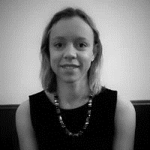
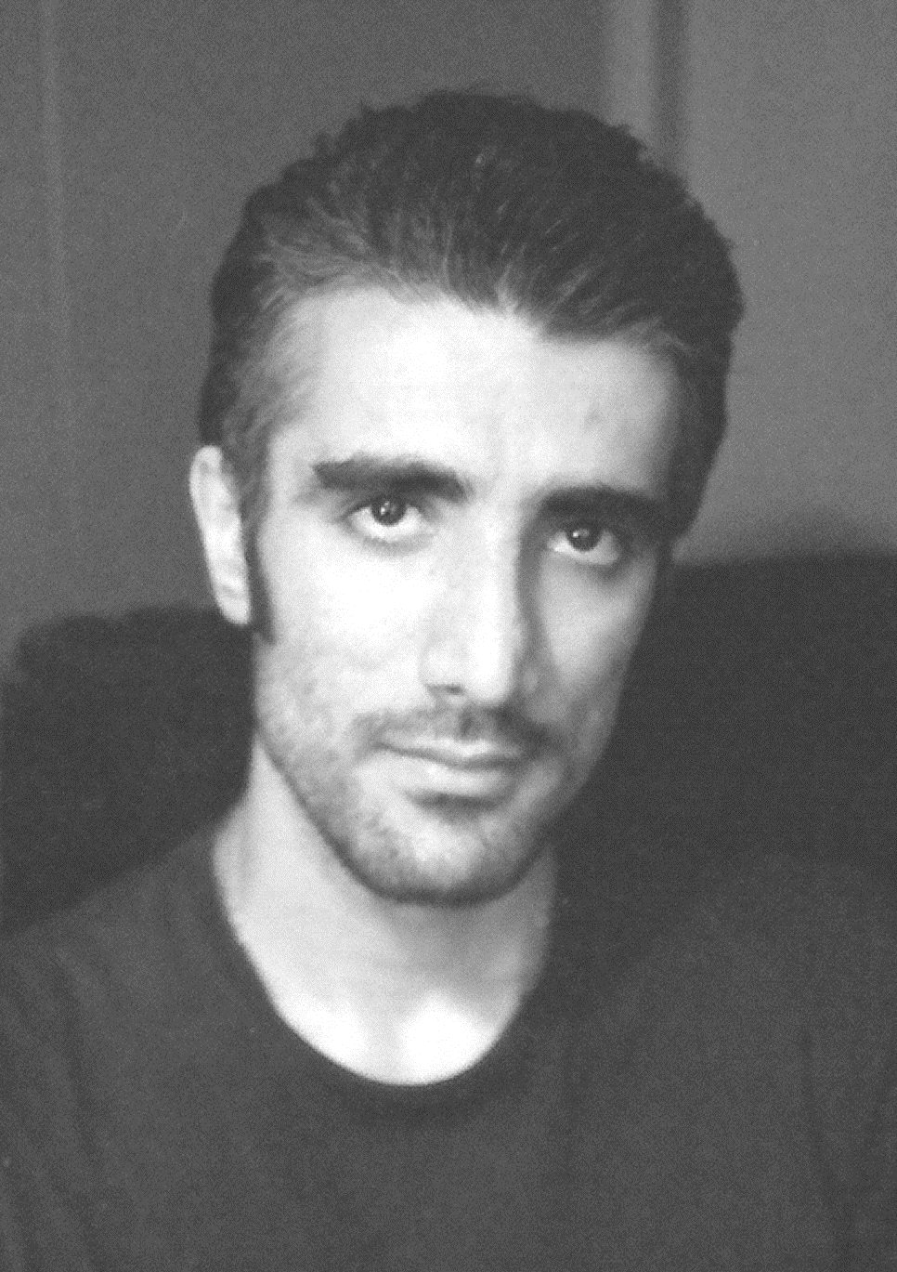










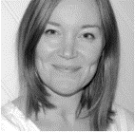





…with 6 industry partners…
1. TOD & Transit
Laura Aston
2. Big Data & Visualisation
Homayoun Rafati
9. Future Train
Lisa Fu
10. Designing Urban Rail to Reduce Vandalism
Amy Killen
3. Network Synchronisation
Rejitha Ravindra
4. Shared Mobility
Taru Jain
11. Bus & Tram Priority Implementation
James Reynolds
12. Simulating Bus & Tram Priority
Samithree Rajapaksha
5. Changing Travel Behaviour
Laura McCarthy
6. Tourism & Public Transport
Victoria Radnell
13. Placemaking & Street Redesign
Matthew Diemer
14. Passenger Falls in Trams
Luke Valenza
7. Reliability Engineering Approaches in Best Practice Railways
Maryam Nawaz
8. Improving Gender Diversity in the Public Transport Workforce
Rachel Mence
15. Transit Network Design
Nora Estgfäller
16. Future Bus
Sarah Roberts
17. The New Bus Rider
Prudence Blake
18. Road Safety Impacts of Bus Safety Inspections
Jianrong Qiu

Slide 13
PTRG Overview
HOT COLLABORATION TOPICS
1. Optimising Revenue Protection
2. Managing Transport Disruption
3. Equity & On-Demand/Shared Mobility

Slide 14
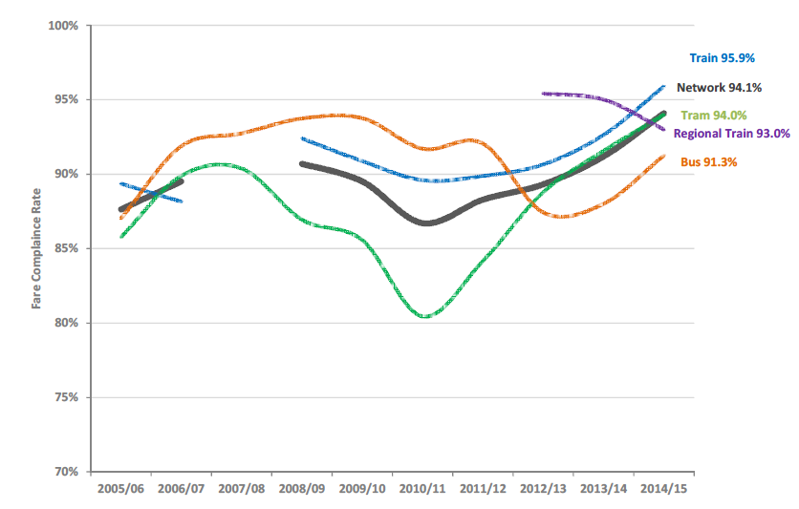

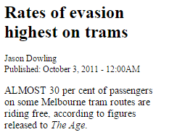
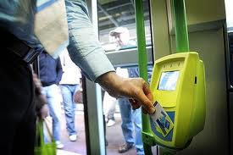
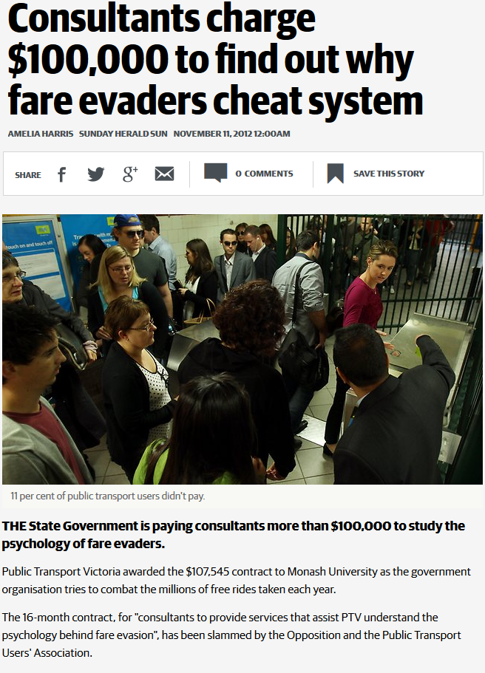
Understanding the Psychology of Fare Evasion Behaviour – The project & its inception
14% fare evasion
Bus
Rail
20% fare evasion
The Age Newspaper:
October 3, 2011
Tram
PTRG Fare Psychology Study
“a waste of public transport funds as it was unlikely to reveal anything startling.”
PTUA
“[The Minister] has made a lot of dopey and bizarre decisions, but spending over $100,000 of taxpayers' money to 'understand the psychology a fare evaders' has got to be close to the top of the list,“
OPPOSITION TRANSPORT SPOKESPERSON

Slide 15
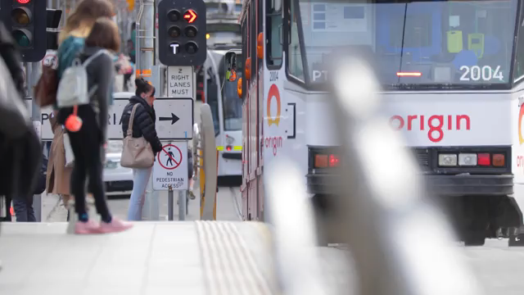
Findings; Insights

Slide 16
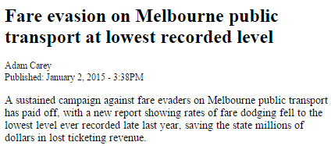
IMPACT
6%
14% fare evasion
20% fare evasion
The Age Newspaper: January 2, 2015
Source: Public Transport Victoria Victorian Official Fare Compliance Series May 2015
PTRG Fare Psychology Study

Slide 17
IMPACT – Over $105mp.a. in savings in Australia ; much larger in overseas cities
IMPACT - Large improvement in revenue protection ~$105M p.a. savings in Melbourne and Sydney since 2015; more reductions internationally
Research Awards:
2016 - Best Research Paper – World Conference on Transport Research
2017 - ARRB Inaugural Research Impact Award
2017 - Vice Chancellors Award for Research Impact

Slide 18
Key Finding: most fare loss is a few frequent users..
Table 5.3: Estimated Volume of Trips Made by Fare Evasion Frequency and Public Transport Trip Frequency Groups
 |  |  | Estimated Fare Evasion Trips Made by People in Each Evasion Frequency Group (M p.a.)
Estimated Share of Trips Involving Evasion |  |  | 6-7 days a week | 5 days a week | 3-4 days a week | 1-2 days a week | > monthly | Less often | Total Trips (M) | Share of Total Travel | Share of Evasion Trips
Always | 100.0% |  | 1.2 | 2.9 | - | - | - | 0.0 | 4.1 | 0.8% | 16%
Almost Always | 95.0% |  | 1.1 | 4.6 | - | - | 0.0 | 0.0 | 5.8 | 1.1% | 22%
Mostly | 75.0% |  | 0.9 | 3.7 | 2.7 | 0.6 | 0.1 | 0.0 | 7.9 | 1.5% | 30%
Regularly | 37.5% |  | 0.4 | 0.7 | 0.8 | 0.3 | 0.1 | 0.0 | 2.3 | 0.4% | 9%
Occasionally | 12.5% |  | 0.1 | 2.8 | 1.3 | 0.4 | 0.1 | 0.0 | 4.8 | 0.9% | 18%
Rarely | 1.0% |  | 0.0 | 0.6 | 0.4 | 0.2 | 0.0 | 0.0 | 1.2 | 0.2% | 5%
Never | 0.0% |  | - | - | - | - | - | - | 0 | 0.0%
Sub-Total: Fare Evasion Trips (M p.a.) |  |  | 3.8 | 15.4 | 5.2 | 1.4 | 0.4 | 0.1 | 26.2 | 5.1% | 100%
Share of Total Evasion |  |  | 14.3% | 58.7% | 19.9% | 5.4% | 1.4% | 0.3%
Recidivists
68% of all FE trips
65,400 people
81% high frequency PT
users
High Frequency Users who Fare Evade
73% of all FE trips
285,900 people
75% Recidivists
All Fare Evaders
822,200 people (20.6% of Melbourne population)
71% (580,000 people) a one off occurrence never
to be repeated

Slide 19
…”recidivists” contrast with accidental evaders
Contrasting Fare Evader Metrics
Measure | Fare Evader Type
 | Recidivists | Meant to pay, accident, one off |  | Deliberate | Unintentional
Share of people fare evading at least once p.a. | 8% | 70% |  | 41.0% | 44.0%
Share of revenue lost/fare evasion trips | 68% | 5% |  | 77.4% | 15.5%
Estimated Value of Revenue Lost p.a. | $54M | $4M |  | $47.8M | $9.6M
Number of People | 65,400 | 580,000 |  | 702,240 | 1,388,520
Share of Melbourne population | 1.6% | 14.5% |  | 17.6% | 34.8%
Lost Revenue per person p.a. | $826 | $6.90 |  | $68.00 | $6.90

Slide 20
Deliberate FE is driven by (dis)honesty, (weak) perceived control and permissive views
Key Points
(dis) honesty a critical driver
Ease of evasion next followed by permissive attitudes
(dis) honesty and Permissive attitudes linked
View PT is provided for commercial (profit) motives affects permissive views
Negative Servicescape views not a direct driver
Personality factors a secondary issue
DELIBERATE
Fare Evasion
likelihood
Source: Currie G and Delbosc A (2017) ‘An Empirical Model for the Psychology of Deliberate and Unintentional Fare Evasion’ TRANSPORT POLICY Volume 54, February 2017, Pages 21–29

Slide 21
Accidental FE is driven by (dis)honesty permissive views and (poor) ticketing competence
Key Points
(dis) honesty a main driver followed by permissive attitudes then ticketing competence
Ease of evasion is not an issue since evasion is accidental/ unintended
Ticketing competence a valuable concept in understanding accidental fare evasion
UNINTENTIONAL
Fare Evasion
likelihood
Source: Currie G and Delbosc A (2017) ‘An Empirical Model for the Psychology of Deliberate and Unintentional Fare Evasion’ TRANSPORT POLICY Volume 54, February 2017, Pages 21–29

Slide 22
Research Collaboration Ideas – Sensitivity of fare evasion rates to ticket checking
Key Points
Doubling ticket inspection rate from 1.31% (average rate in 2011) to 2.62% would act to reduce fare evasion on trams from 18.13% to 12.26%.
doubling rates acts to reduce fare evasion rates by about a third.
Implies an elasticity of about -0.32

Slide 23
PTRG Overview
HOT COLLABORATION TOPICS
1. Optimising Revenue Protection
2. Managing Transport Disruption
3. Equity & On-Demand/Shared Mobility

Slide 25
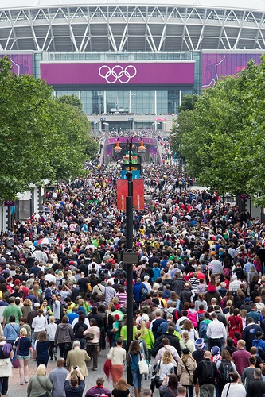
Monash research identified the approach used to manage PLANNED disruption in congested summer Olympic games host cities
Olympic Transport Approach
Increase
Supply
Transit
Orientation
Maximize
Available
Transport
Capacity
Reduce
Base
Load
Demand
Management
Lower
Service
Quality
Expectations
Source: Currie G and Delbosc (2011) ‘Assessing Travel Demand Management for the Summer Olympic Games’ TRANSPORTATION RESEARCH RECORD Journal of the Transportation Research Board Volume 2245 / 2011 Pages 36-48

Slide 26
5 key strategies are adopted; for B: travel behaviour change…
A. Travel Capacity
Creation Measures
Olympic
Travel
Demand
Management
Measures
B. Travel Behaviour
Change/Marketing
C. Traffic
Efficiency Measures
D. Traffic
Bans
E. Public Transport
Emphasis
Source: Currie G and Delbosc (2011) ‘Assessing Travel Demand Management for the Summer Olympic Games’ TRANSPORTATION RESEARCH RECORD Journal of the Transportation Research Board Volume 2245 / 2011 Pages 36-48

Slide 27
Active behaviour change aim to match demand to available capacity
 | London 2012 | Athens 2004 | Sydney 2000 | Atlanta 1996 | Barcelona 1992 | Soeul 1988 | Los-Angeles 1984 | Moscow 1980 | Salt Lake 2002
The big scare, travel warnings & communications strategies | ✔ | ✔ | ✔ | ✔ |  |  | ✔ |  | ✔
Employer/business telecommuting/ work retiming | ✔ | ✔ | ✔ | ✔
Test events as education | ✔ | ✔ | ✔
Spectator public transport use education | ✔ |  | ✔ |  |  |  |  |  | ✔
Resident public transport use education | ✔ |  | ✔ |  |  |  |  |  | ✔
Affected business/community consultation and travel plans | ✔ | ✔ | ✔ | ✔ |  |  | ✔ |  | ✔
B. Travel Behaviour
Change/Marketing

Slide 28
Monash developed the concept of the ‘Big Scare’ - highly successful in reducing base load
 | London 2012 | Athens 2004 | Sydney 2000 | Atlanta 1996 | Barcelona 1992 | Soeul 1988 | Los-Angeles 1984 | Moscow 1980 | Salt Lake 2002
The big scare, travel warnings & communications strategies | ✔ | ✔ | ✔ | ✔ |  |  | ✔ |  | ✔
Employer/business telecommuting/ work retiming | ✔ | ✔ | ✔ | ✔
Test events as education | ✔ | ✔ | ✔
Spectator public transport use education | ✔ |  | ✔ |  |  |  |  |  | ✔
Resident public transport use education | ✔ |  | ✔ |  |  |  |  |  | ✔
Affected business/community consultation and travel plans | ✔ | ✔ | ✔ | ✔ |  |  | ✔ |  | ✔
B. Travel Behaviour
Change/Marketing
The “Big Scare” - Communication Strategy
Developed after Atlanta 1996
  Stop ‘Over-Promising’
  UNDER PROMISE AND OVER DELIVER
  Its not possible to cater for total demand so tell people to SCARE them into thinking about alternative options
  Morally Wrong? – Its ALSO telling the TRUTH
Source: Currie, G Jones, A and Woolley J (2015) 'Travel Demand Management and the 'Big Scare' - Impacts and Lessons on Travel in London during the 2012 Olympic Games' TRANSPORTATION RESEARCH RECORD Volume 2469 pp 11-22

Slide 29
Pro-active communications strategies create doubt about normal travel options – combined with….
 | London 2012 | Athens 2004 | Sydney 2000 | Atlanta 1996 | Barcelona 1992 | Soeul 1988 | Los-Angeles 1984 | Moscow 1980 | Salt Lake 2002
The big scare, travel warnings & communications strategies | ✔ | ✔ | ✔ | ✔ |  |  | ✔ |  | ✔
Employer/business telecommuting/ work retiming | ✔ | ✔ | ✔ | ✔
Test events as education | ✔ | ✔ | ✔
Spectator public transport use education | ✔ |  | ✔ |  |  |  |  |  | ✔
Resident public transport use education | ✔ |  | ✔ |  |  |  |  |  | ✔
Affected business/community consultation and travel plans | ✔ | ✔ | ✔ | ✔ |  |  | ✔ |  | ✔
B. Travel Behaviour
Change/Marketing
The “Big Scare” - Communication Strategy
London 2012 – Business Advice
  Find the travel hot spots
  Plan ahead
  Consider all your travel options
  Avoid the busiest times if you can
  Avoid driving into affected areas if you can
Simple Marketing Message
  “Have a Pint”
Key Messages
  Reduce
  Reroute
  Retime
  Remode
Source: Currie, G Jones, A and Woolley J (2015) 'Travel Demand Management and the 'Big Scare' - Impacts and Lessons on Travel in London during the 2012 Olympic Games' TRANSPORTATION RESEARCH RECORD Volume 2469 pp 11-22

Slide 30
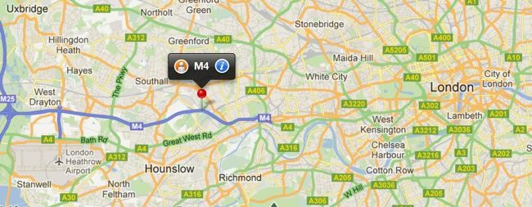
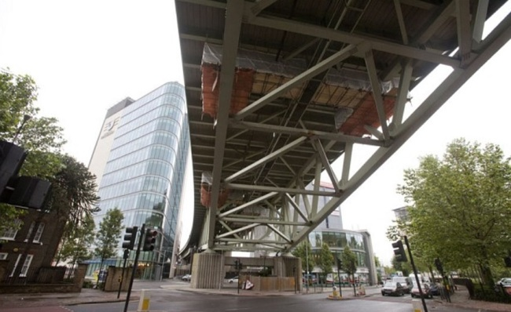
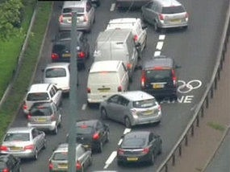
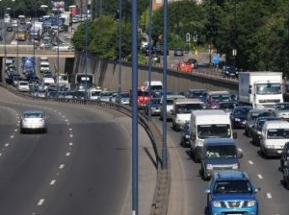
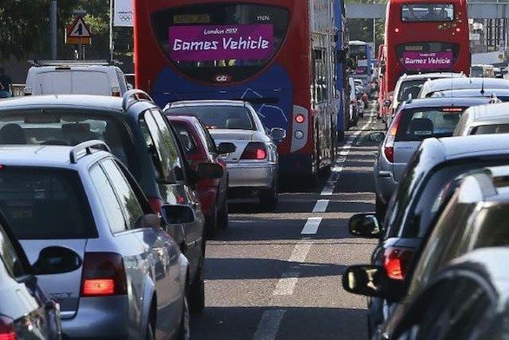
Pre Games – Media Traffic Chaos “Hysteria”
…(free) media ‘hysteria’ – much influence was leveraged to reduce demand
Fears of Olympic road chaos as main motorway from Heathrow to London is closed for at least FIVE days due to cracked viaduct
Emergency plans being drawn up as Olympic road stays shut
51km jam: Olympians stall London.
London 2012 Olympics travel chaos: live

Slide 31
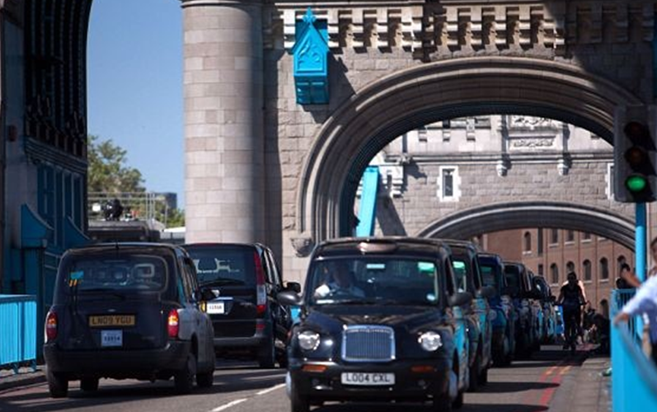
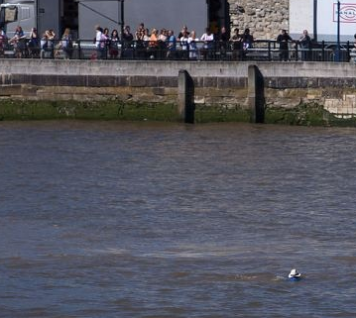
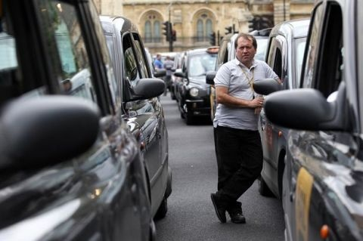
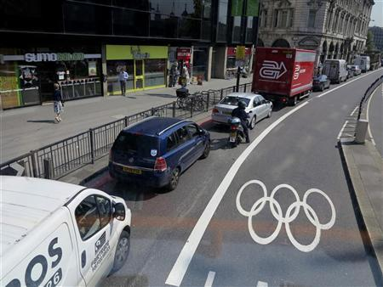
Pre Games – Media “Hysteria” on Traffic Chaos
…(free) media influence was leveraged to reduce demand
London Cab Drivers Protest Olympic Dedicated Traffic Lanes
London cabbies block traffic in Olympic protest
Horse-drawn hearses could hijack Olympic lanes
‘Coffin on a Bus’

Slide 32
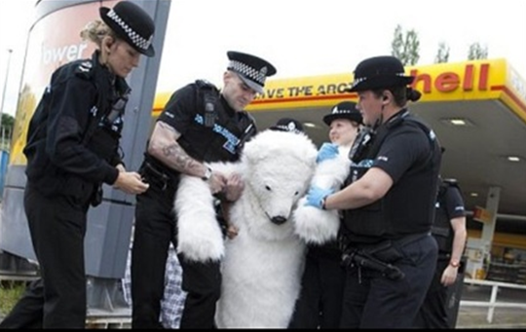
Pre Games – Media “Hysteria” on Traffic Chaos
…(free) media influence was leveraged to reduce demand
Greenpeace Polar Bears Close
Olympic Transport

Slide 33
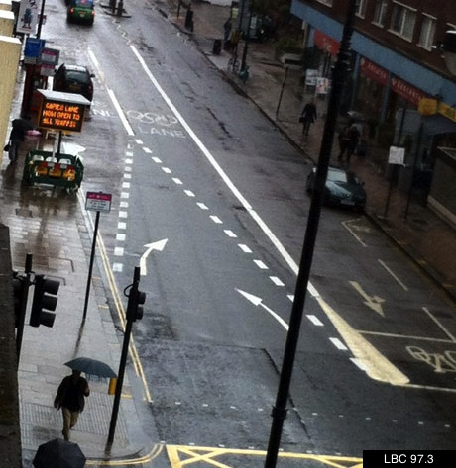
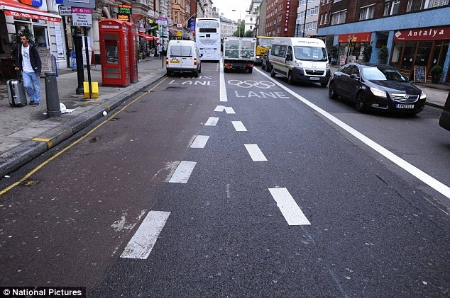
Pre Games – Media “Hysteria” on Traffic Chaos
…(free) media influence was leveraged to reduce demand
Lost! Games Lanes cause chaos and leave athletes unimpressed
London's hydrogen buses grounded during Olympics due to security fears!

Slide 34
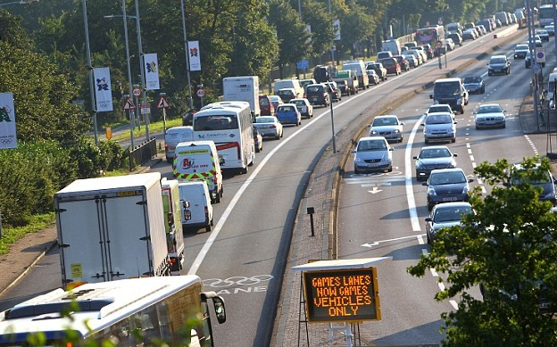
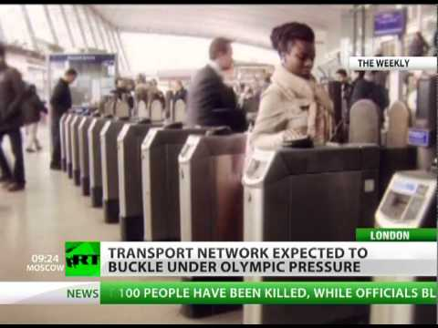
Pre Games – Media “Hysteria” on Traffic Chaos
…(free) media influence was leveraged to reduce demand
Travel misery signals more trouble ahead during Olympic Games
A 'perfect traffic storm' will bring Olympic chaos to London as 33% more cars clog roads and motors crawl along at 12mph

Slide 35
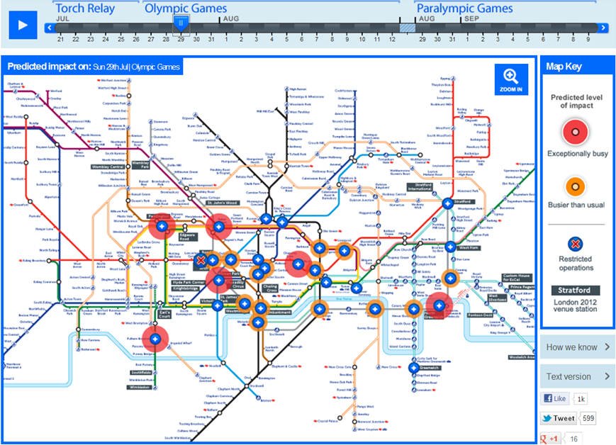
‘Keep ahead of the games website – a modelling innovation

Slide 36
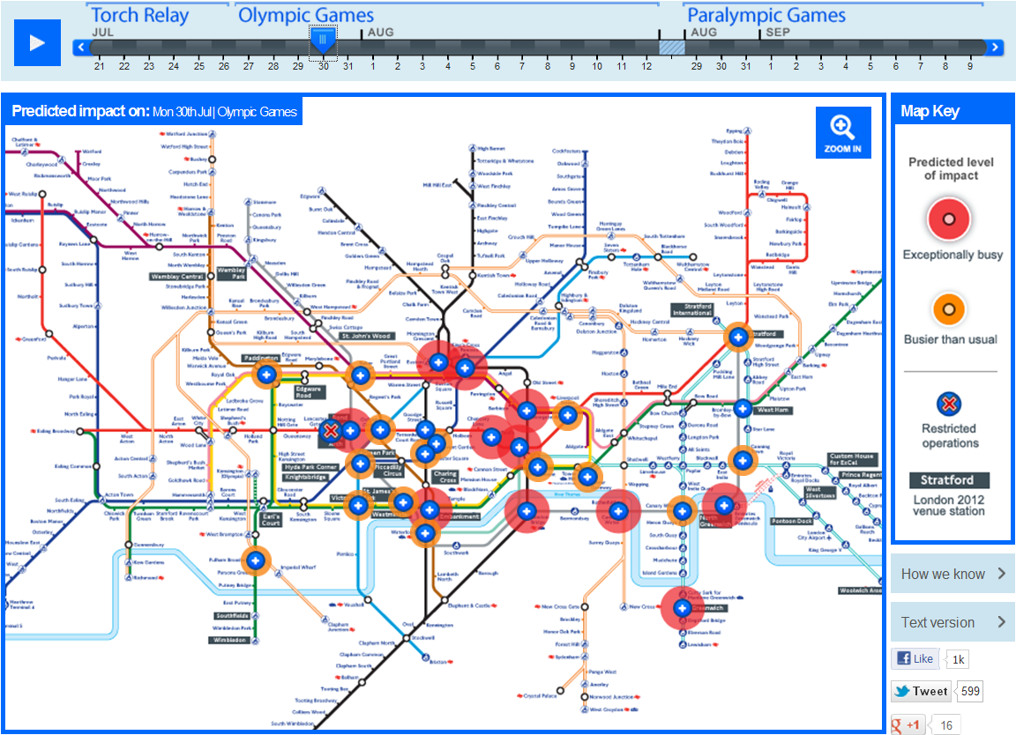
‘Keep ahead of the games website – a modelling innovation

Slide 37
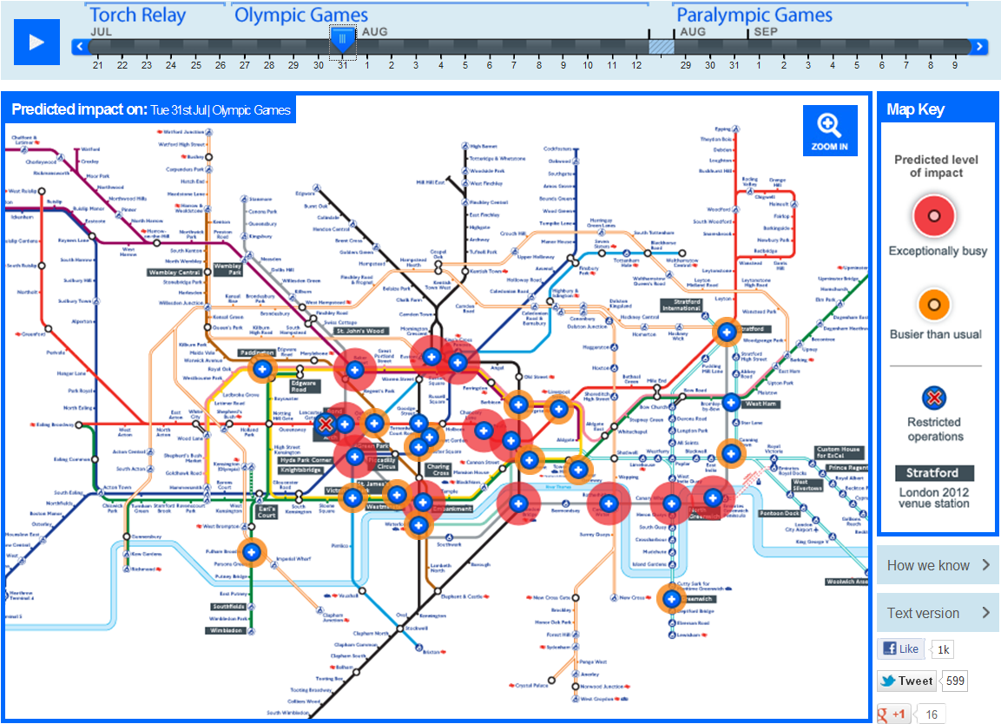
‘Keep ahead of the games website – a modelling innovation

Slide 38
Games Time

Slide 39
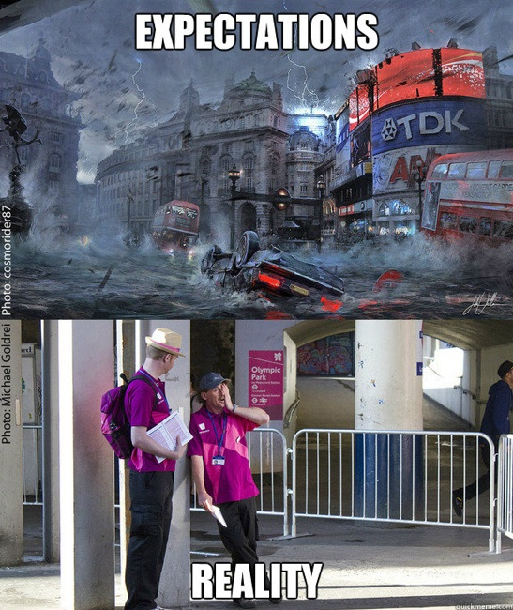
Ghost town London: 'Victims of our own success'

Slide 40
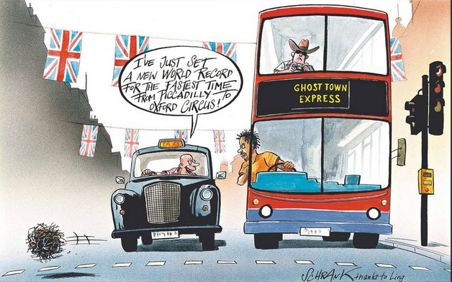
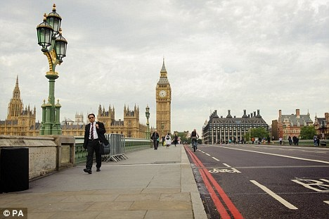
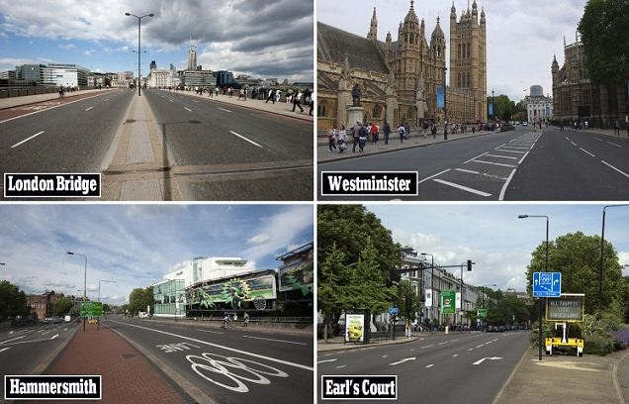
Games Time – where have all the people gone?
Media Banner
“Ghost Town London”

Slide 41
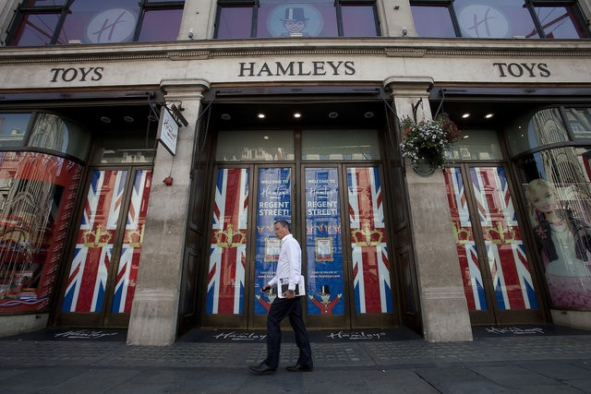
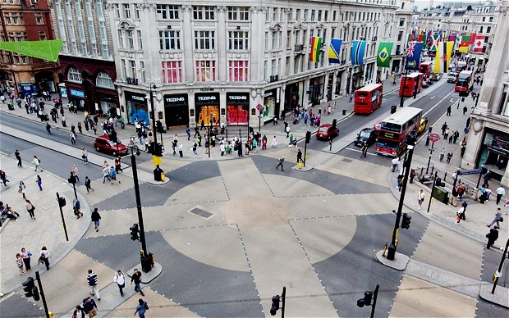
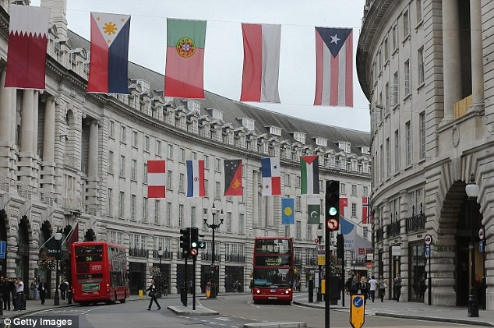
Traders complain about lack of business
Olympics-London tourist trade suffers from Olympic effect
Olympics Hurt London Store Sales as Shoppers Stay Away From City

Slide 42
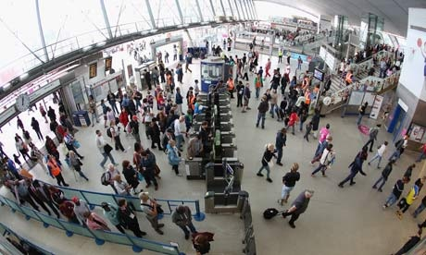
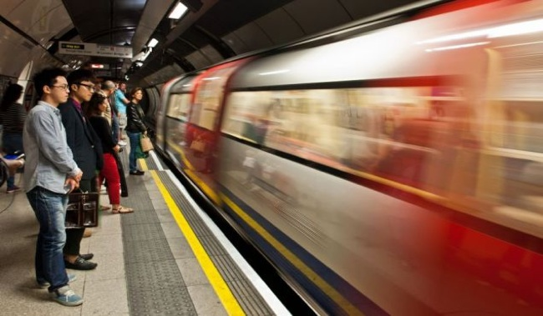
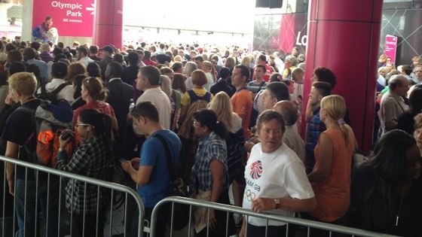
Games Time – Public Transport Working Well
Press Reports – Day 3
Many reports of Public Transport working very smoothly; trains buses very quiet; tube/trains “fantastic” – some commuters complain they get to work too early
Gold-star performance by transport on first full working day of Olympics

Slide 43
Games Time – Transit Mode Shift....
Mode Shift
Commuter Quote: Day 3
Is it just me or is public transport actually quieter than normal? Can we host the Olympic Games more often please
Change in Ridership Compared to Last Year
Source: TfL Published Data
Day 11 – Tuesday 7th LUL carries 4.5M passengers – Largest demand in all History
Source: Journey Maker Survey

Slide 44
Games Time – Transit Mode Shift....
Games Travel Intentions
Business/Commuter Intentions
Work from Home
  65% commuters said they would do this
  59% of businesses said they were happy for employees to work from home
Other options
  Vacation (Sydney = 27%)
  10% of Britons leaving the UK during the games (Assoc of British Travel Agents)
Travel Adjustments During the Games
Share of Response
Source: Journey Maker Survey
Source: Monash Business Survey – preliminary results

Slide 45
...consistent with previous games
Atlanta 1996
Sydney 2000
Athens 2004
Perceived that peak congestion reduced by 30%
Radial traffic down 4-6%
Peaks more spread
Peak road travel times reduced by 50%
Road traffic between 10-20% less than normal
Travel time reductions of up to 66% reported by media (2hrs to 40 mins for travel across city)
F Dimou – Coutroubas reports 30% base load reduction on main roads

Slide 46
PTRG Overview
HOT COLLABORATION TOPICS
1. Optimising Revenue Protection
2. Managing Transport Disruption
3. Equity & On-Demand/Shared Mobility

Slide 47










PTRG led a major international research exploring links between Social Exclusion transport and quality of life

Slide 48




Measuring social equity across transport markets – Lorenze curves and Gini coefficients
Income by Population
Service Supplied by Population
Source: Delbosc A and Currie, G. (2011) ‘Using Lorenz Curves to Assess Public Transport Equity’ JOURNAL OF TRANSPORT GEOGRAPHY Volume 19, Issue 6, November 2011, Pages 1252-1259

Slide 49


Measuring social equity across transport markets – Lorenze curves and Gini coefficients
Service Supplied by Population
Service Supplied by Population
Source: Ricciardi, A Xia C, Currie G (2015) 'Exploring Public Transport Equity between Separate Disadvantaged Cohorts: A Case Study in Perth, Australia' JOURNAL OF TRANSPORT GEOGRAPHY Volume 43, February 2015, Pages 111-122
Source: Delbosc A and Currie, G. (2011) ‘Using Lorenz Curves to Assess Public Transport Equity’ JOURNAL OF TRANSPORT GEOGRAPHY Volume 19, Issue 6, November 2011, Pages 1252-1259

Slide 50

Measuring social equity across transport markets – Lorenze curves and Gini coefficients
Service Supplied by Population
Source: Ricciardi, A Xia C, Currie G (2015) 'Exploring Public Transport Equity between Separate Disadvantaged Cohorts: A Case Study in Perth, Australia' JOURNAL OF TRANSPORT GEOGRAPHY Volume 43, February 2015, Pages 111-122

Slide 51




Contact us via our website PTRG.INFO, LinkedIn or Twitter
Professor Graham Currie FTSE
Director, SEPT-GRIP, PTRG
www.ptrg.info

